Slide 1

Susquehanna River School of Art (SRSA)
Introducing the vision of our community as a cultural and artistic trail.
TM
WELCOME

Slide 2
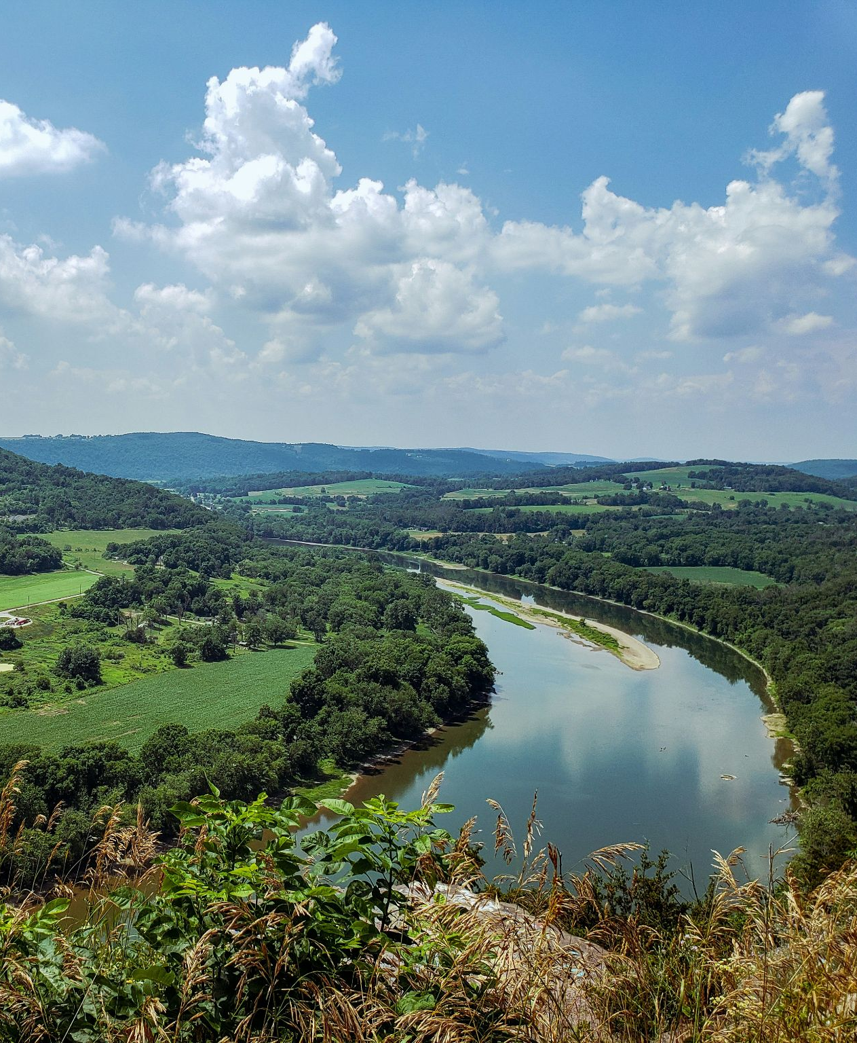
Our Vision
The Susquehanna River School of Art connects art, culture, and the natural beauty of the region, fostering a vibrant creative community.

Slide 3
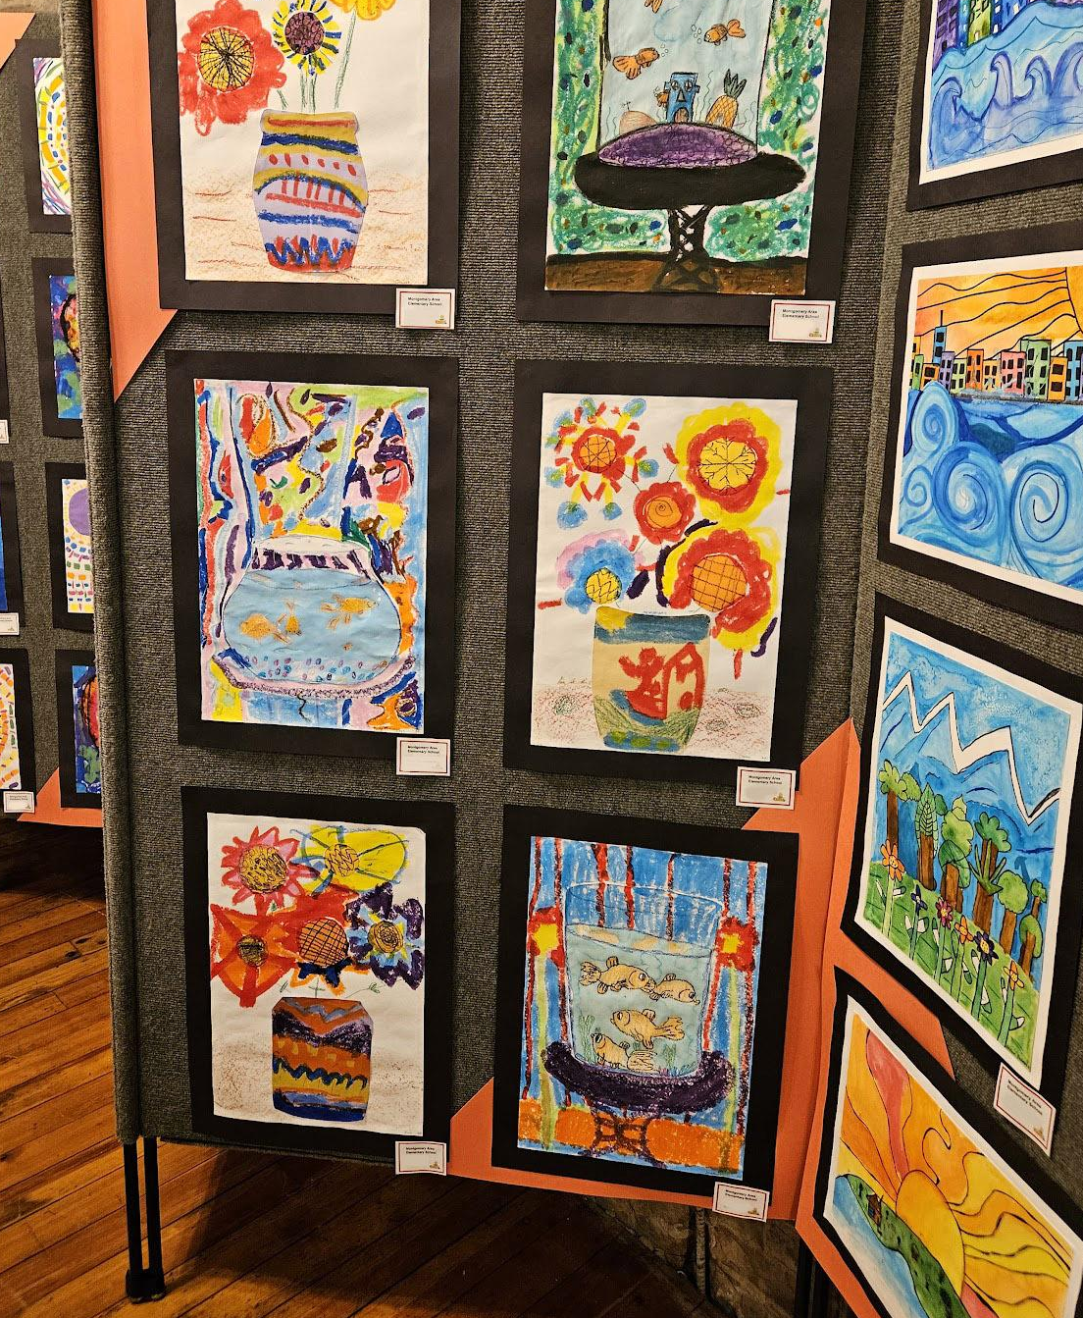
Why This Matters
Artists and art lovers are drawn to our area for its natural beauty, affordability and inspiration.
Art improves our way of life in our river towns.

Slide 4
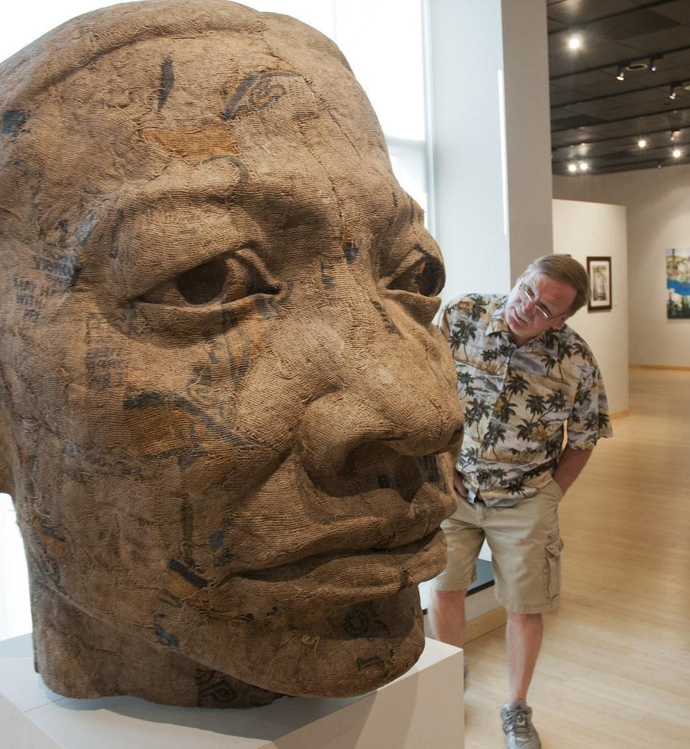
What Are We?
An interactive website and cultural trail map.
A team of volunteers promoting the arts and history within our community and to visitors to our region.
Ongoing promotional campaigns.
Educational programs and events.

Slide 5
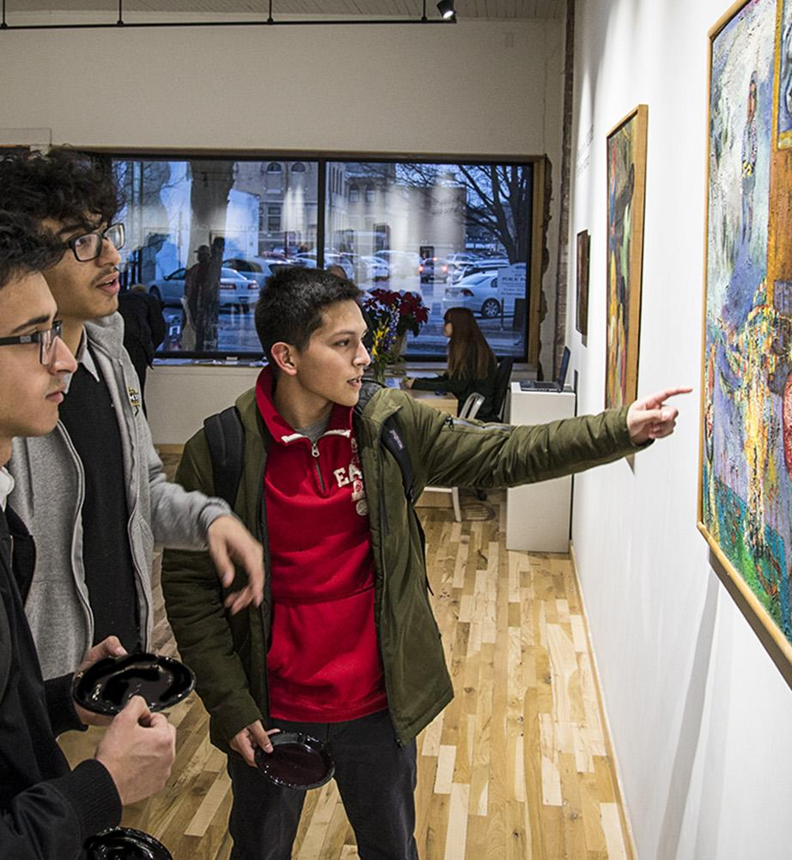
Benefits for Art Venues & Organizations
Gain visibility, attract visitors, and be part of a larger arts movement in Central PA.

Slide 6
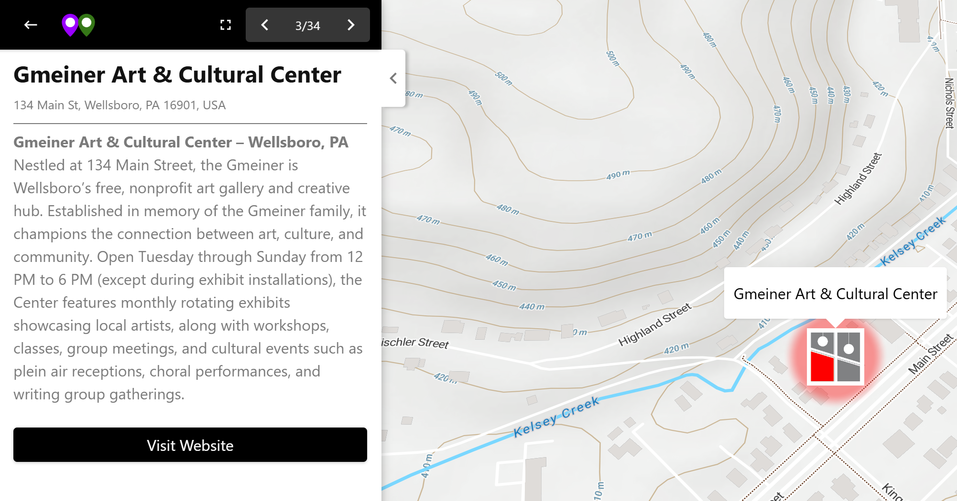
Complementary Listings
What You Get
Your venue on our interactive map with link to your website
Website traffic resulting from our marketing efforts

Slide 7
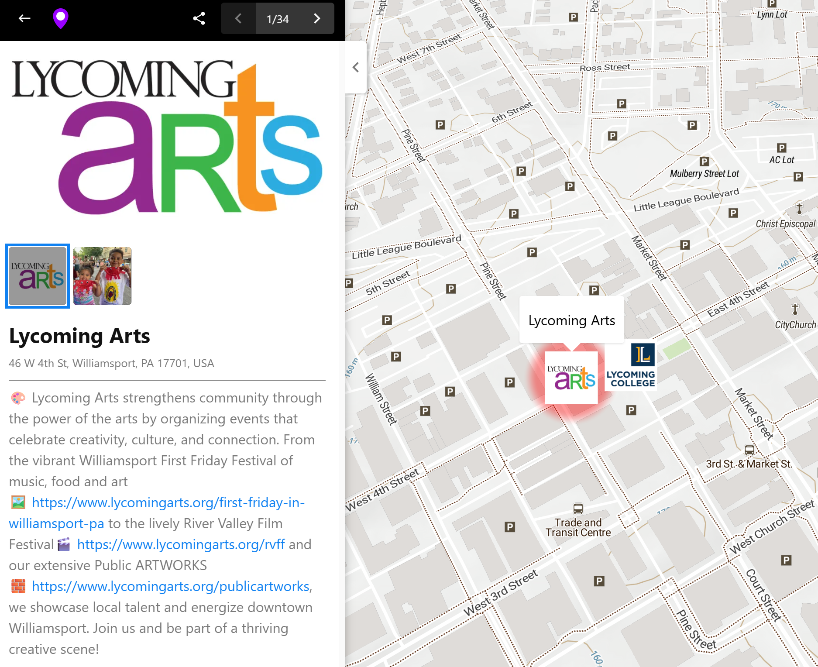
Landmark Listings
What You Get
$100 Per Year
Enhanced website listing
Photos, links to your website
Featured social media post
Google Adwords traffic
Rack brochure distribution

Slide 8
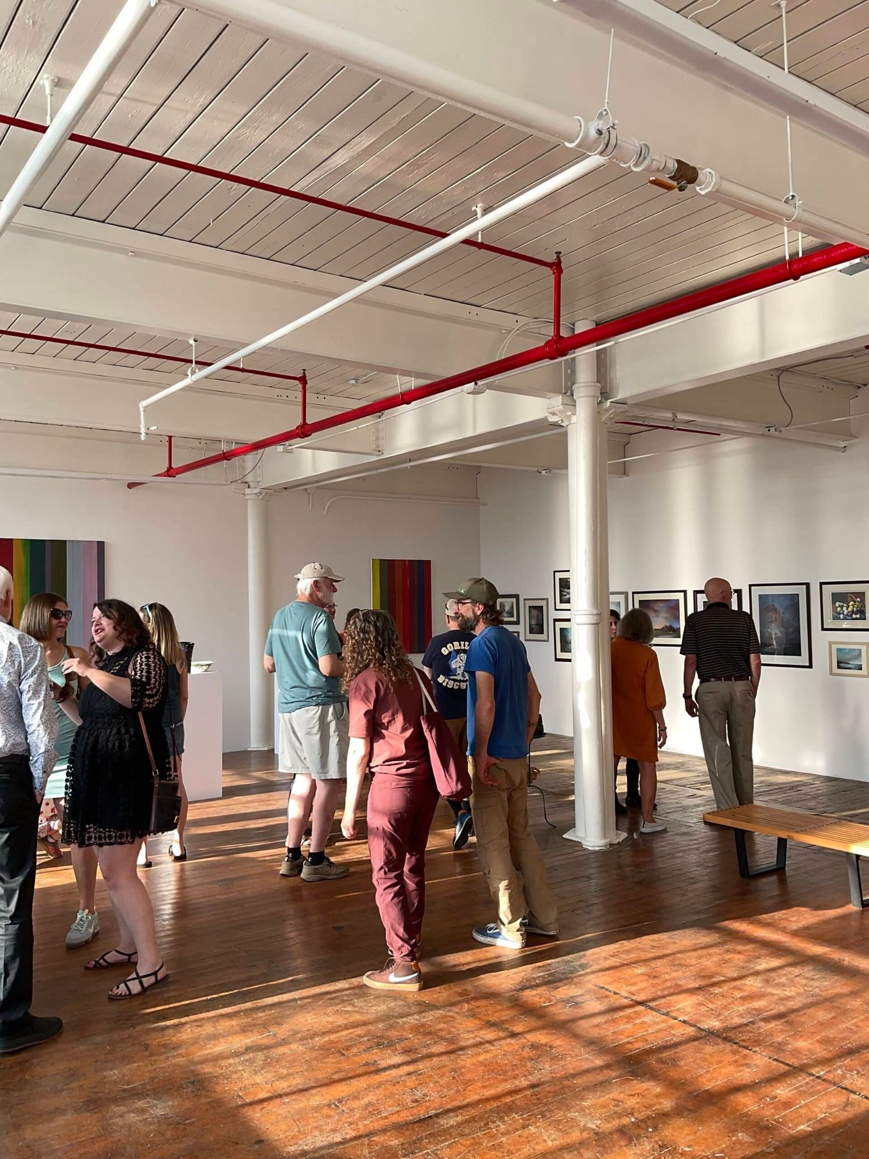
Sustaining Members
$1,000 Per Year
Collaboration and Cross-marketing with Other Arts Organizations
Branding Central PA as a Cultural Trail
Expanded Access to Grants through Partnerships

Slide 9
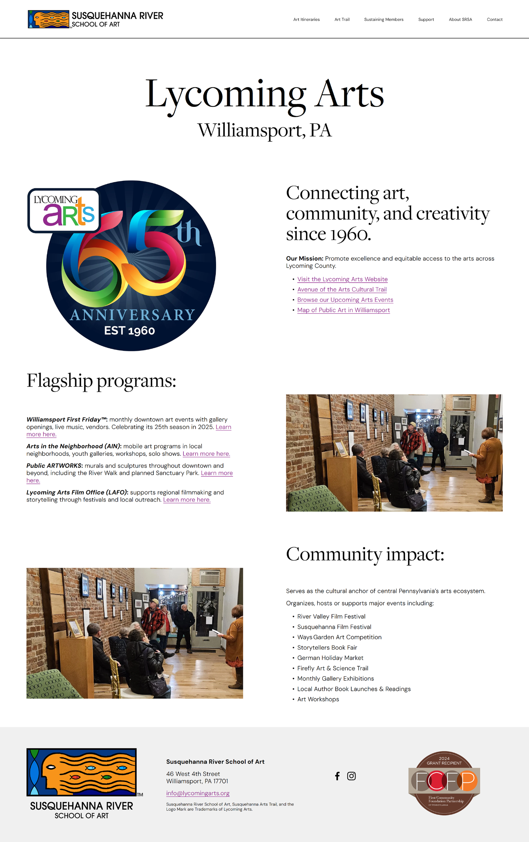
Sustaining Members
Custom Web Page Profile of
Your Organization

Slide 10
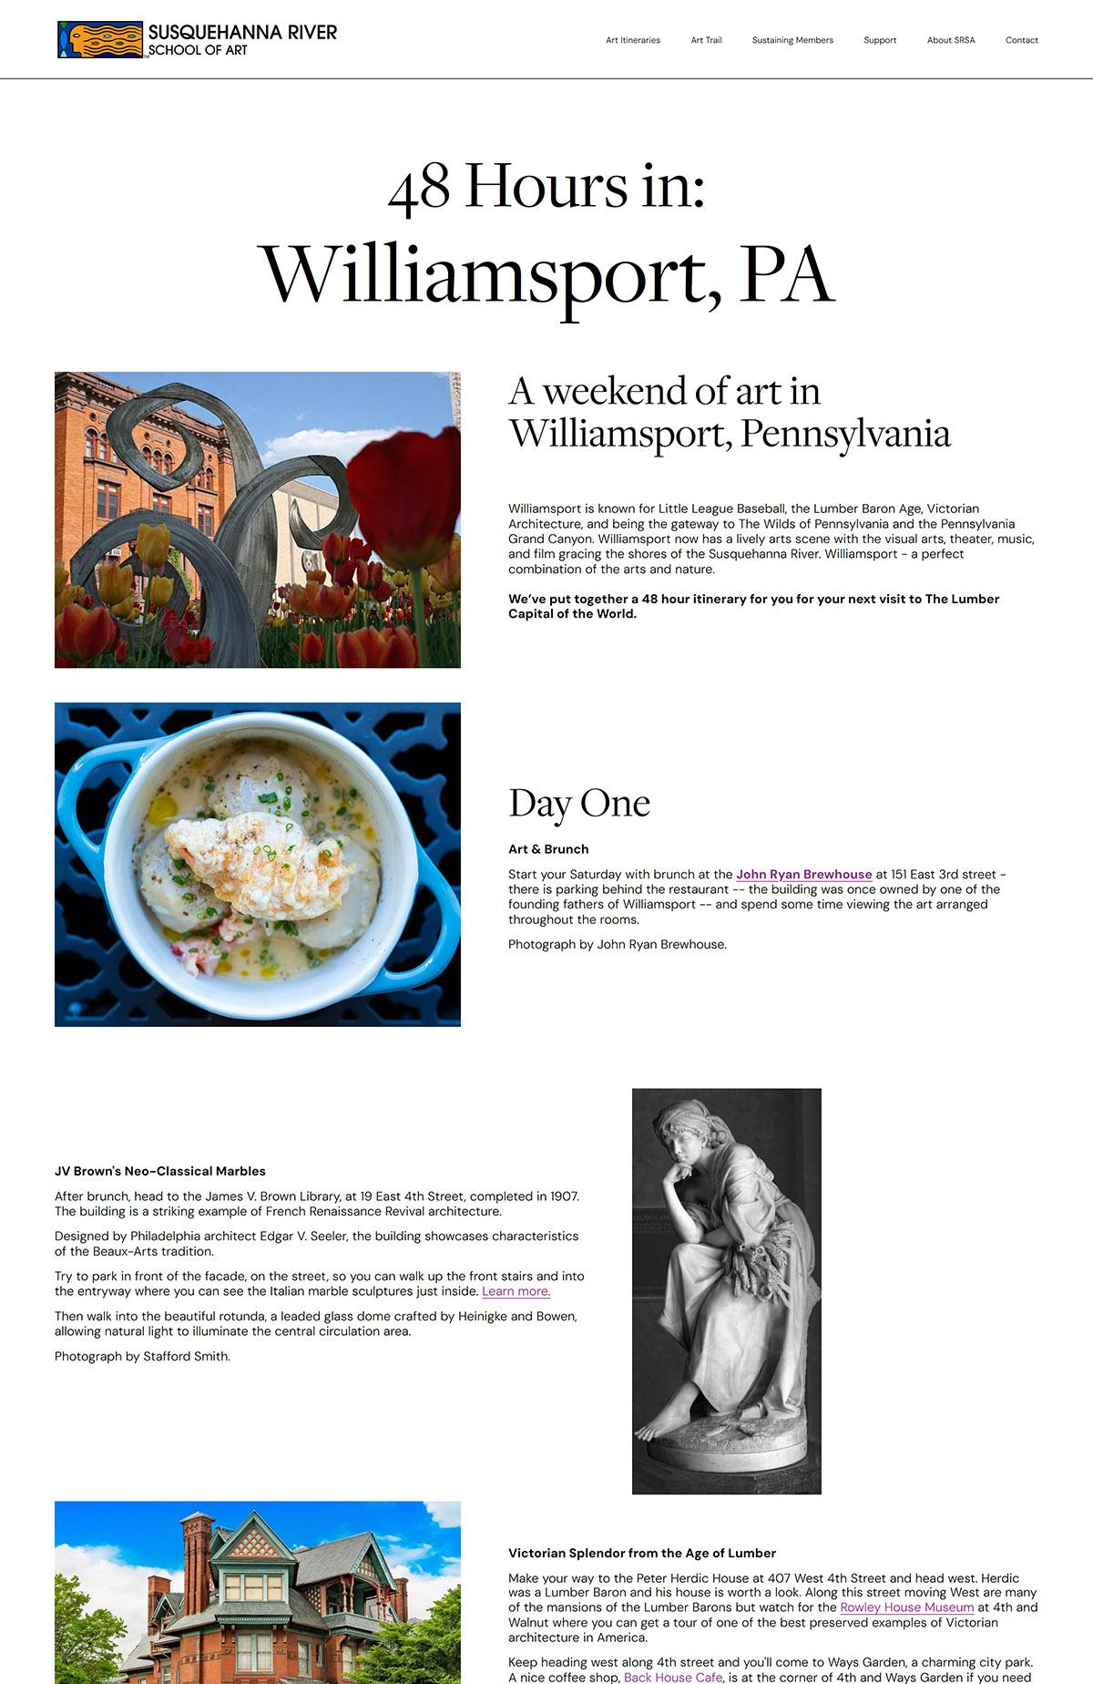
Sustaining Members
Custom 48 Hours Art Itinerary Page of Your Community

Slide 11
Sustaining Members
Increased Awareness through SRSA Marketing
Google Adwords Campaigns ($10K/M)
Social Media (Facebook & Instagram)
Email Marketing
Billboards
Rack Card & Distribution

Slide 12
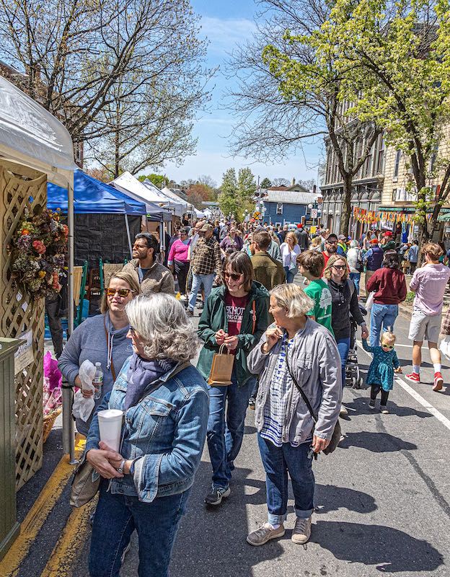
How to Get Involved
Complementary Listing
Landmark Listing for $100
Donate to SRSA
Provide images and content*
Become a volunteer!
Notes:
Over decades, Lycoming Arts has accumulated thousands of supplied images from many organizations. We credited images on our website and marketing when we could, but any organization that wants different images, or current images removed, simply has to let us know at info@lycomingarts.org.

Slide 13
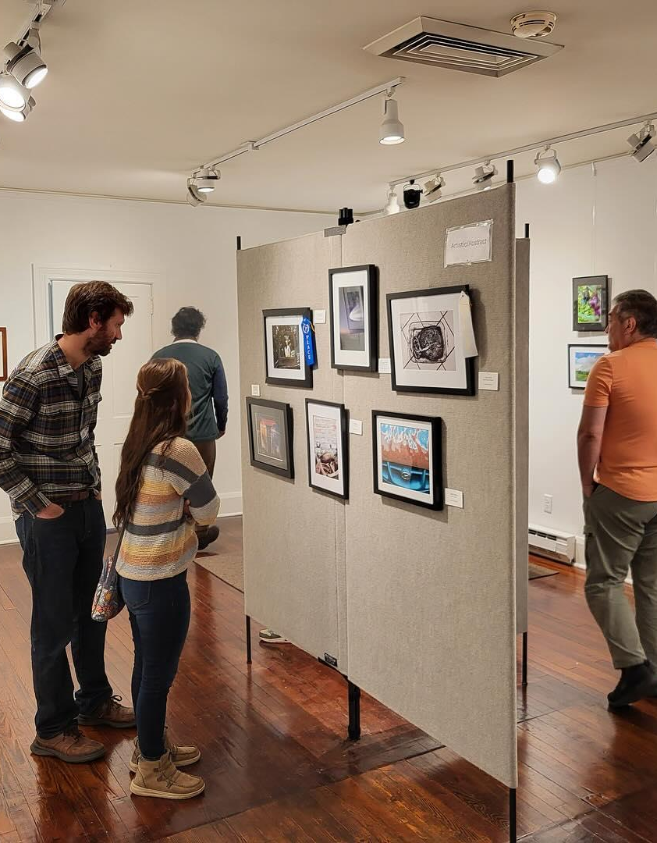
Thank You & What’s Next?
Let’s bring art and nature together—join us in making this vision a reality!
LATE SPRING 2025
Website Launch
FALL 2025 - SPRING 2026
Social Media Launch
Brochure Distribution
Digital Ad Campaign Launch
Billboards Campaign

